Slide 1

CS244
Advanced Topics in Networking
Lecture 6: Switching
Nick McKeown
“High-speed switch scheduling for local-area networks”
[Tom Anderson, Susan Owicki, James Saxe, Chuck Thacker. 1993]
Spring 2020

Slide 2
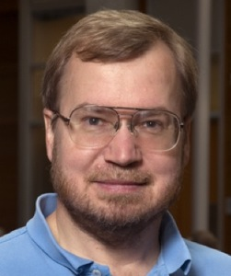

Context
Tom Anderson
At the time: DEC SRC (Palo Alto)
Professor of CS, University of Washington
Previously: UC Berkeley, EECS
?
James B. Saxe
At the time: DEC SRC (Palo Alto)
After that: Compaq and HP Labs
Susan Owicki
At the time: DEC SRC (Palo Alto)
Before that: Prof of EE & CS, Stanford
Today: Marriage and Family Therapist, Palo Alto
Chuck Thacker (d. 2017)
At the time: DEC SRC (Palo Alto)
Before that: Xerox PARC (“Alto”)
After that: Microsoft
2010 Turing Award Winner
At the time the paper was written…
WWW was new, and Internet traffic was growing fast
Fastest Ethernet networks ran at 100Mb/s
Lots of interest in building faster switches and routers
Lively debate about an alternative to the Internet, called “ATM”

Slide 3
But first…

Slide 4
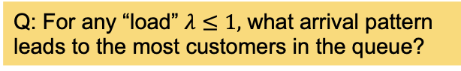
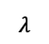
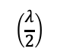
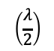

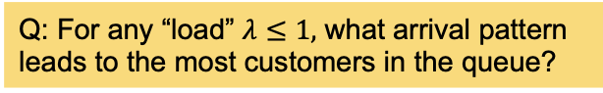

A few words about packet queues…
R = line rate.
e.g. 100M bit/s, 10Gb/s
$$\left(\frac{λ}{2}\right)$$
Packet buffer
R
R
R
R
$$λ$$
$$\left(\frac{λ}{2}\right)$$
R
Q: For any “load” $λ≤1,$ what arrival pattern leads to the most customers in the queue?
Q: For any “load” $λ≤1,$ what arrival pattern leads to the most customers in the queue?
q(t)
Cumulative arrivals, A(t)
R
Cumulative arrivals, A(t)
2R
R
Cumulative bits
Cumulative bits
gradient $≤$ R
gradient $≤2$R
time
time
Observation: With one arrival “line” at the same rate, the queue is always empty (or at most one store-and-forward packet). The arrival process is “bounded” by R.
Observation: The arrival rate is “bounded” by R on average.

Slide 5

Different cases for $λ=1$
1
3
line 1
line 1
line 2
line 2
1.5
2
0.5
1
3hr
4hr
time, s
1hr
2hr
time
Q: How big does the buffer need to be?
Q: How big does the buffer need to be?
Observation: For a given arrival rate, in order to know the queueing delay, we need to know the pattern (or “process”) of arrivals.
2
line 1
line 2
1.5
2
0.5
1
time, s
Q: How big does the buffer need to be?

Slide 6
Background
3
1
R
R
2
4
R
2
R
R
1
R
R
…
3
R
R
N
…
…
…
A switch, or router, with N “ports”.
Each port runs at rate R b/s.
We say the “switching capacity” is N x R b/s.
N
R
R

Slide 7
An output-queued (OQ) switch
1
R
R
Properties of an OQ switch
All buffering takes place at the output.
Output queues must be able to write packets at rate N x R.
2
R
R
Consequences
“Work conserving”: Whenever there is a packet in the system, its output is busy sending a packet. No unnecessary idling.
Average delay is minimized.
But memory bandwidth limits the switching capacity.
3
R
R
…
N
R
R

Slide 8
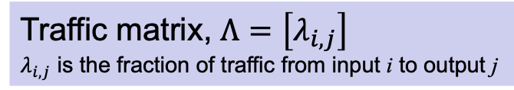
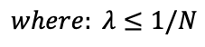
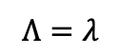
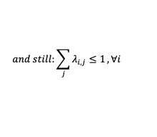
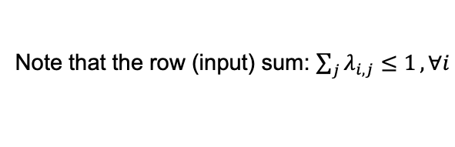
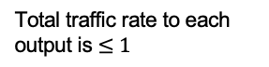
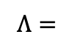
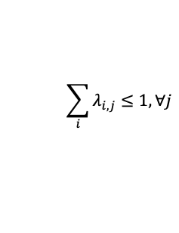
Traffic Matrix
Traffic matrix, $Λ=\left[λ_{i,j}\right]$
$λ_{i,j}$ is the fraction of traffic from input i to output j
1
R
R
0.1
0.2
0.2
For example:
0.4
R
0.1 0.2 0.2 0.4
0.2 0.3 0.1 0.1
1.0 0.0 0.0 0.0
0.1 0.4 0.3 0.1
2
R
$$Λ=$$
3
R
R
Note that the row (input) sum: $\sum_{j}{λ_{i,j}≤1}, ∀i$
Non-oversubscribed TM:
Uniform Traffic Matrix:
…
Total traffic rate to each output is $≤1$
1
$$1$$
$$1$$
$$1$$
$$Λ=λ$$
$$1$$
$$1$$
$$1$$
$$1$$
$$\sum_{i}{λ_{i,j}≤1, ∀j}$$
N
R
R
$$1$$
$$1$$
$$1$$
$$1$$
$$and still:\sum_{j}{λ_{i,j}≤1}, ∀i$$
$$1$$
$$1$$
$$1$$
$$1$$
$$where: λ≤1/N$$
Notes:
Note that 1st column of the example is “oversubscribed” to output 1.

Slide 9
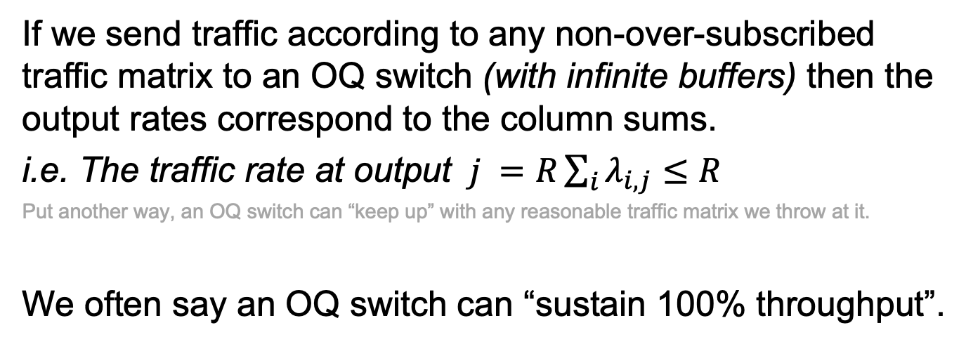
OQ Switches and “100% Throughput”
If we send traffic according to any non-over-subscribed traffic matrix to an OQ switch (with infinite buffers) then the output rates correspond to the column sums.
i.e. The traffic rate at output $j =R\sum_{i}{λ_{i,j}≤R}$
Put another way, an OQ switch can “keep up” with any reasonable traffic matrix we throw at it.
We often say an OQ switch can “sustain 100% throughput”.
Q: What happens if the buffers are finite?

Slide 10
An input-queued (IQ) switch
1
R
R
Properties of an IQ switch
All buffering takes place at the input.
Input queues only need to be able to write packets at rate R (instead of N x R).
2
R
R
Consequences
Can build a switch N times faster.
But, a packet can be held up by packet ahead destined to a different output.
Hence an IQ switch is not “work conserving”. It can unnecessarily idle.
May not achieve “100% throughput”.
Average delay is not minimized.
3
R
R
…
N
R
R

Slide 11
Head of Line Blocking

Slide 12
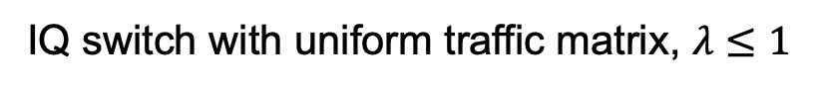
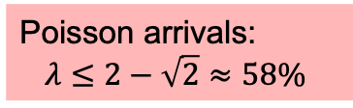
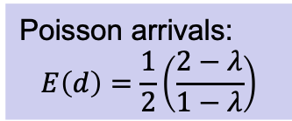
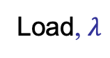
Head of Line Blocking
IQ switch with uniform traffic matrix, $λ≤1$
Observation: HOL Blocking means we lose
42% of the switching capacity
Delay, d
Poisson arrivals:
$$λ≤2−\sqrt{2}≈58\%$$
OQ Switch
Poisson arrivals:
$$E\left(d\right)=\frac{1}{2}\left(\frac{2−λ}{1−λ}\right)$$
Karol ‘87
IQ Switch
5/2
3/2
0
0.5
0.58
0.75
1
Load, $λ$
Notes:
Uniform is the most benign traffic pattern.
Poisson is the most benign arrival process.
Yet, HOL blocking limits IQ to only 58.6%

Slide 13
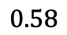
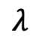
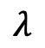
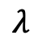
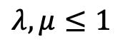
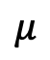
What does the “58%” result mean?
Arrival rate
Departure rate
$$μ$$
$$λ$$
R
R
1
R
R
$$λ,μ≤1$$
2
R
R
OQ switch
3
R
R
Arrival rate
Departure rate
$$λ$$
R
R
…
IQ switch uniform TM, Poisson
R
R
Arrival rate
Departure rate
N
$$λ$$
R
R
$$0.58$$

Slide 14
Virtual Output Queues (VOQs)

Slide 15
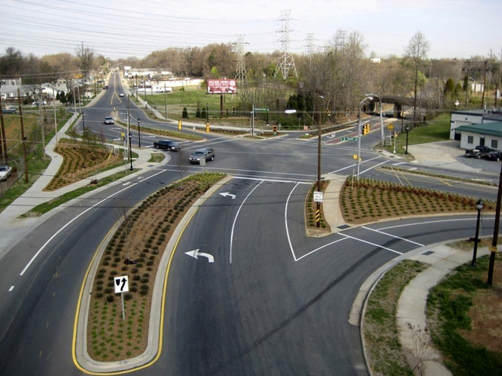

Slide 16
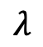
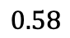
Basic idea
With a VOQ, a packet cannot be held up by a packet in front of it, destined to a different output.
Q: With VOQs, does/can 58% become 100% throughput?
IQ switch uniform TM, Poisson
IQ switch with VOQs
Any TM, Any arrivals
?
Arrival rate
Departure rate
Arrival rate
Departure rate
$$λ$$
R
$$λ$$
R
R
$$0.58$$
R

Slide 17
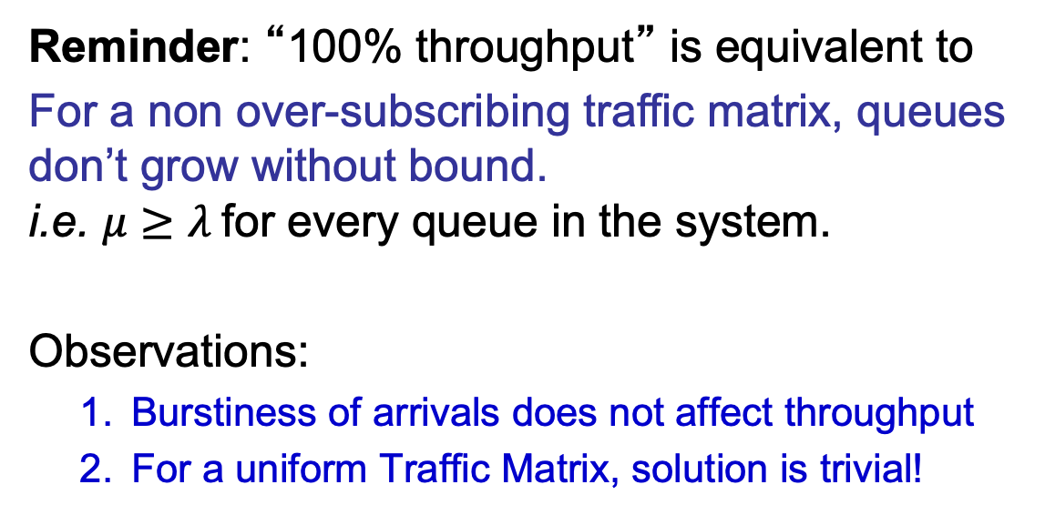
100% Throughput
Reminder: “100% throughput” is equivalent to
For a non over-subscribing traffic matrix, queues don’t grow without bound. i.e. $μ≥λ$for every queue in the system.
Observations:
Burstiness of arrivals does not affect throughput
For a uniform Traffic Matrix, solution is trivial!

Slide 18
An input-queued (IQ) switch with VOQs and a crossbar
N² VOQs
1
R
R
1
R
R
1
2
R
R
2
R
R
2
3
R
R
3
R
R
3
crossbar
…
…
Observation: scheduling is equivalent to choosing a permutation.
…
N
R
R
N
R
R
N

Slide 19
N² VOQs
bipartite
request
graph
bipartite
match
crossbar
e.g. “maximum size match”

Slide 20
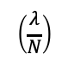
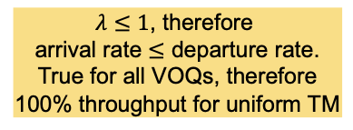
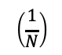
Crossbar schedule
$λ≤1$, therefore
arrival rate $≤$ departure rate.
True for all VOQs, therefore
100% throughput for uniform TM
Fixed cycle of permutations:
uniform TM
$$\left(\frac{λ}{N}\right)$$
$$\left(\frac{1}{N}\right)$$
schedule
R
R
crossbar
crossbar
crossbar
crossbar

Slide 21
100% throughput for uniform traffic
Four (trivial) algorithms for a uniform traffic matrix:
Cycle through permutations in “round-robin” (i.e. previous slide).
Each time, randomly pick one of the permutations in (1).
Each time, pick a permutation uniformly and at random from all possible N! permutations.
Wait until all VOQs are non-empty, then pick any algorithm above.

Slide 22
Quick recap so far

Slide 23
An input-queued (IQ) switch
1
R
R
Properties of an IQ switch
All buffering takes place at the input.
Input queues only need to be able to write packets at rate R (instead of N x R).
2
R
R
Consequences
Can build a switch N times faster.
HOL Blocking: a packet can be held up by packet ahead destined to a different output.
Hence an IQ switch is not “work conserving”. It can unnecessarily idle.
May not achieve “100% throughput”.
Average delay is not minimized.
3
R
R
…
N
R
R

Slide 24
Head of Line Blocking
IQ switch with uniform traffic matrix, $λ≤1$
Observation: HOL Blocking means we lose
42% of the switching capacity
Delay, d
Poisson arrivals:
$$λ≤2−\sqrt{2}≈58\%$$
OQ Switch
Poisson arrivals:
$$E\left(d\right)=\frac{1}{2}\left(\frac{2−λ}{1−λ}\right)$$
Karol ‘87
IQ Switch
5/2
3/2
0
0.5
0.58
0.75
1
Load, $λ$
Notes:
Uniform is the most benign traffic pattern.
Poisson is the most benign arrival process.
Yet, HOL blocking limits IQ to only 58.6%

Slide 25
100% throughput easy for uniform traffic
Four (trivial) algorithms for a uniform traffic matrix:
Cycle through permutations in “round-robin”.
Each time, randomly pick one of the permutations in (1).
Each time, pick a permutation uniformly and at random from all possible N! permutations.
Wait until all VOQs are non-empty, then pick any algorithm above.

Slide 26
Q: So why did the authors need Parallel Iterative Matching (PIM)?
Because in practice, arrivals are not uniform.
(If know the matrix, we can still create a cycle of permutations to serve every VOQ at the rate in the traffic matrix).
In practice we don’t know the traffic matrix.
Hence, PIM….

Slide 27
Parallel Iterative Matching A maximal bipartite match
uar selection
uar selection
1
1
1
1
1
1
Iteration 1:
2
2
2
2
2
2
3
3
3
3
3
3
4
4
4
4
4
4
Request
Grant
Accept
Q: Are we done?
Q: Is a larger match possible?
1
1
1
1
1
1
2
2
2
2
2
2
Iteration 2:
3
3
3
3
3
3
4
4
4
4
4
4

Slide 28
PIM Properties
Inputs and outputs make decisions independently and in parallel.
Guaranteed to find a maximal match in at most N iterations.
Typically completes in much fewer than N iterations.
Q: How large is a maximal match compared to a maximum match?
A maximal match is guaranteed to be at least half the cardinality (size) of a maximum match.

Slide 29
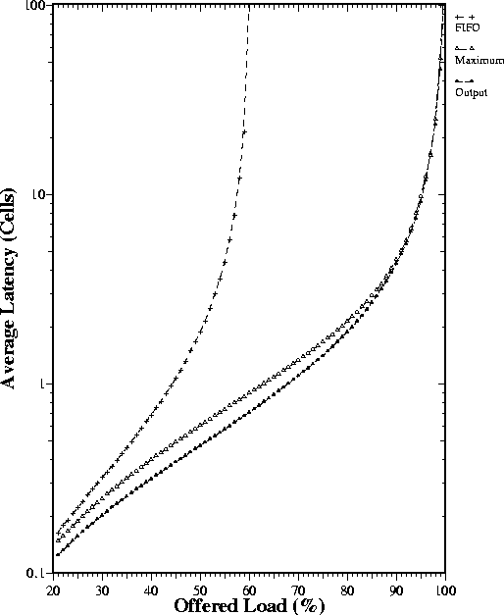
Parallel Iterative Matching
IQ + FIFO
VOQ + Maximum
Size Match
Output Queued
Note log scale
Simulation
16-port switch
Uniform traffic matrix

Slide 30
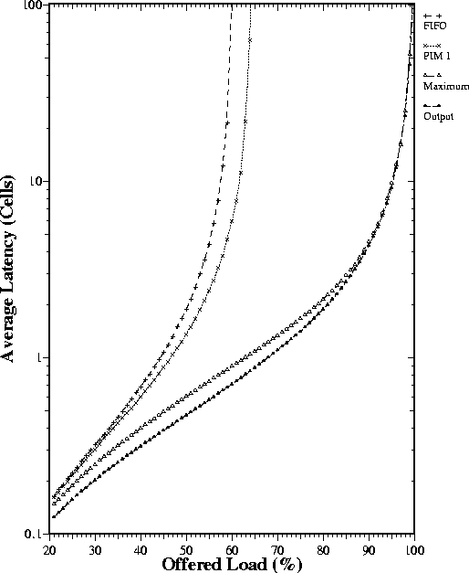
Parallel Iterative Matching
PIM with one iteration
IQ + FIFO
VOQ + Maximum
Size Match
Output Queued
Simulation
16-port switch
Uniform traffic matrix

Slide 31
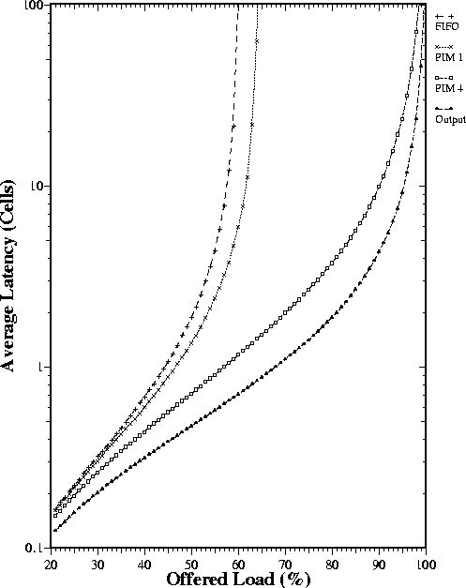
Parallel Iterative Matching
PIM with one iteration
IQ + FIFO
PIM with four iterations
Output Queued
VOQ + Maximum Size Match
Simulation
16-port switch
Uniform traffic matrix

Slide 32
How many PIM iterations should be run?

Slide 33
Parallel Iterative Matching Number of iterations
Consider the n requests to output j
k
Requesting inputs receiving no other grants
j
n-k
Requesting inputs receiving other grants

Slide 34
Known methods for non-uniform traffic
1. 100% throughput is now known to be theoretically possible with:
IQ switch, with VOQs, and
An arbiter to pick a permutation to maximize the total matching weight (e.g. weight is VOQ occupancy)
M, Walrand and Anantharam, 1996

Slide 35
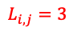
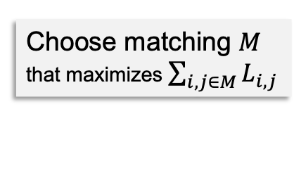
Choose matching $M$
that maximizes $\sum_{i,j∈M}{L_{i,j}}$
N² VOQs
bipartite
request
graph
bipartite
match
1
2
1
3
crossbar
3
$$L_{i,j}=3$$
“maximum WEIGHT match”
Observation: give preference to longer VOQs
Leads to 100% throughput for any traffic matrix.

Slide 36
Known methods for non-uniform traffic
2. It is practically possible with:
IQ switch, VOQs, all running twice as fast (i.e. choose and transfer two cells per cell time)
An arbiter running a maximal match (e.g. PIM)
Intuition: Because maximal match is at least half the size of a maximum match, running twice as fast compensates for it.
Dai and Prabhakar, 2000

Slide 37
Known methods for non-uniform traffic
3. 2 switch stages with a fixed schedule of permutations!
C-S Chang, 2001

Slide 38
A 2-stage Load-balancing switch
Fixed cycle of permutations
Fixed cycle of permutations
N² VOQs
1
R
1
R
R
1
2
R
2
R
R
2
3
R
3
R
R
3
crossbar
…
…
Intuition: If uniform traffic is so easy, can I make
non-uniform traffic “sufficiently uniform”?
…
N
R
N
R
R
N

Slide 39
A 2-stage Load-balancing switch
N² VOQs
1
R
R/N
R/N
R
1
R/N
R/N
2
R
R
2
3
R
R
3
…
…
Deceptively simple but works for non-uniform traffic!
Q: Where is the switching taking place?
Q: Can packets be mis-sequenced?
N
R
R
N

Slide 40
End.

